Slide 1
EE-383 Semester Project
Ajin Sunny
Derek King

Slide 2
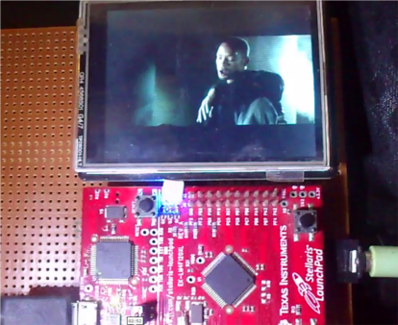
The Project
Using the Tiva Launchpad as a video player
Idea from the source below, however, we want to make this video player “smart”
Adding motion sensor capabilities
Hoping to add functionality like touching to pause, IR receiver capabilities, etc.
http://blog.vinu.co.in/2013/04/stellaris-launchpad-based-video-player.html#more

Slide 3
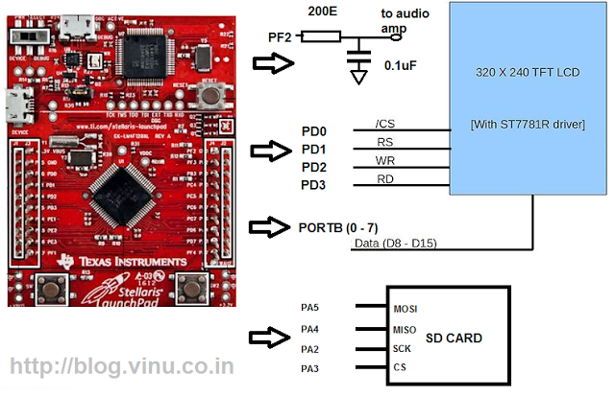
Details
Video files will be read in from an SD or MicroSD card wired to the breadboard
Initial circuit diagram showed to the left. Requres reading data from SD card on PortA and using PortD to send the video to the LCD screen

Slide 4
Details cont.
PortB will receive touch data from the LCD screen
PortF will be used to send audio data to the speakers
Another Port will be needed to add IR support as well as any other features we have time for

Slide 5
Milestone Dates
Receive all necessary parts (wiring, motion sensors, etc.) – Nov. 12
Have videos playable on the device – Nov. 21
Added extra capabilities like motion, IR, etc. – Dec. 6

